Slide 1
NHS Wales Staff Survey 2023 – Quantitative Results by Service Delivery Group
Notes:
This slide can be used for presentations which are from a health board-wide perspective or for a whole HB audience as the graphic device to the right of the slide includes all four service group colours and red for the corporate team.

Slide 2
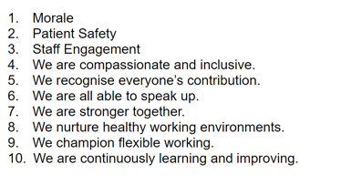
CONTEXT - REMINDER
Led by HEIW – based on NHS England question set, Professor Michael West and the Kings fund research – link to Compassionate Leadership
Launched on 16th October to 4th December 2023 (final count including paper-based) – Open 6 weeks
Electronic, paper-based an phone-line available – greater accessibility and inclusivity
2,625 responses for Swansea Bay UHB – 18.8%
Full quantitative data set by Service Group / Directorate and Staff Group – qualitative data to follow
10 Question areas:

Slide 3
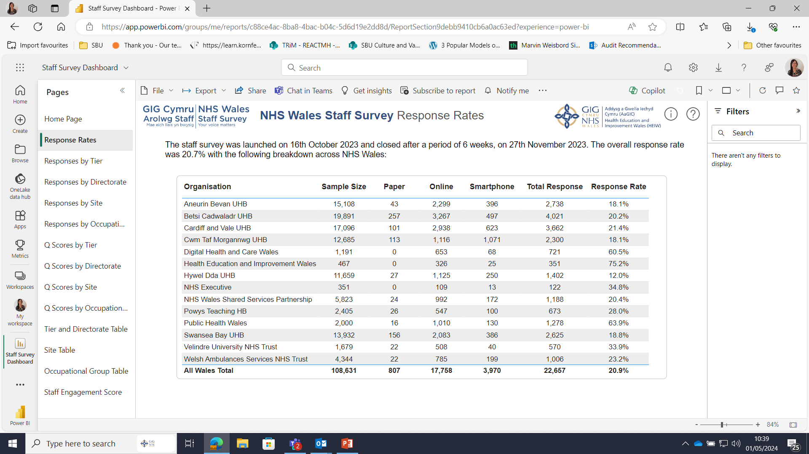
Notes:
This is a generic copy slide.

Slide 4
How do Our Results link with our ‘One Bay Way’ across Service Groups? A High Quality Organisation – Patient Safety
*N.B. New question set for 2023 – no comparible data. Responses are in percentage.
In the last month have you seen any errors, near misses,
or incidents that could have hurt staff and/or patients/service users?
My organisation treats staff who are involved in an error, near miss or incident, fairly.
Notes:
This is a generic copy slide.

Slide 5
Patient Safety Continued…
When errors, near misses or incidents are reported, my organisation takes action to ensure that they do not happen again.
My organisation encourages us to report errors, near misses or incidents.

Slide 6
Patient Safety Continued…
We are given feedback about changes made in response to reported errors, near misses and incidents.

Slide 7
Compassionate Culture (Patients / Service Users)
N.B. New question set for 2023 – no comparible data. Responses are in percentage
People here are compassionate in the way they behave towards patients/service users.
People here take effective action to help patients/service users in distress.

Slide 8
Compassionate Culture continued…
Care of patients/service users is my organisation's top priority.
My organisation acts on concerns raised by patients/service users.

Slide 9
Compassionate Culture (staff to staff)
The people I work with are understanding and kind to one another.
People here are compassionate towards colleagues when they face problems.

Slide 10
A High Quality Organisation – Friends & Family Test
Question | SBUHB Response 2023 | SBUHB Response 2020
If a friend or relative needed treatment I would be happy with the standard of care provided by this organisation | 54% agreed/strongly agreed | 67% agreed/strongly agreed

Slide 11
A High Quality Organisation – Compassionate Leadership
*N.B. Links to People Strategy aim – Leadership that Lives our Values
New Question Set – No Comparable data
My immediate manager (line manger) is interested in listening to me when I describe challenges I face.
My immediate manager (line manger) takes effective action to help me with any problems I face

Slide 12
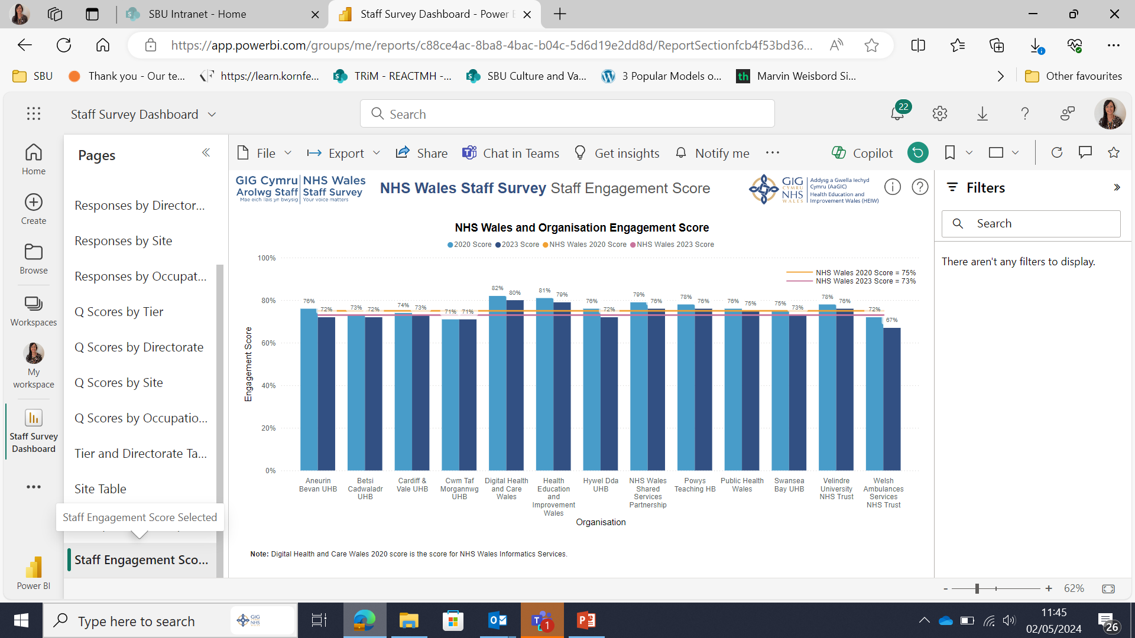
Notes:
This is a generic copy slide.

Slide 13
Our People Strategy – Engagement Score
7 Key questions that specifically measure Staff Engagement
Links to our People Strategy aim - Engaged Motivated & healthy and work of Recruitment & Retention Group
SBU’s score is 73% (down by 2% from 2020) – reflected across NHS Wales
1. I am involved in deciding on changes introduced that affect my work area/team/department.
2. I look forward to going to work.

Slide 14
Our People Strategy - Engagement Score Continued…
4. I am happy to go the extra mile at work when required.
3. I am enthusiastic about my job.

Slide 15
Our People Strategy - Engagement Score Continued…
5. I am able to make improvements in my area of work
6. I would recommend my organisation as a place to work.

Slide 16
Our People Strategy - Engagement Score Continued…
7. I am proud to tell people I work for my organisation.

Slide 17
People Strategy Aim – Engaged, motivated & Healthy
Key Headlines
My immediate manager (line manger) values my work
I am satisfied with the opportunity for flexible working patterns

Slide 18
People Strategy Aim – Engaged, motivated & Healthy
Key Headlines continued…
I have unrealistic time pressures
How often, if at all, do you feel burnt out because of your work?

Slide 19
People Strategy Aim – Engaged, motivated & Healthy
Key Headlines continued…
On average, how many additional UNPAID hours do you work per week for this organisation, over and above your contracted hours?
I often think about leaving this organisation.

Slide 20
Our People Promise – Compassion, inclusivity & belonging
*N.B. Question (asked differently in 2020 / No comparable data))
In the last 12 months how many times have you personally experienced harassment or bullying at work from managers/team leaders?
In the last 12 months how many times have you personally experienced harassment or bullying at work from other colleagues?

Slide 21
Our People Promise – Compassion, inclusivity & belonging continued…
In the last 12 months how many times have you personally experienced harassment or bullying at work from patients/service users, their relatives, or other members of the public?
I think that my organisation respects individual differences (e.g. cultures, working styles, backgrounds, ideas)

Slide 22
Our People Promise – Compassion, inclusivity & belonging continued…
In the last 12 months have you personally experienced discrimination at work from a manager/ team leader?
In the last 12 months have you personally experienced discrimination at work from other colleagues?

Slide 23
Our People Promise – Compassion, inclusivity & belonging continued…
In the last 12 months have you personally experienced discrimination at work from patients/service users, their relatives, or other members of the public?
I’d feel able to speak up in my team if I noticed poor or incorrect practice.

Slide 24
Next Steps
No national Staff Survey Action plan published to date
There are some clear areas of focus both for Service Groups and Corporately, linked to our Vision, People Strategy and ‘One Bay Way’
Service Groups to be given access to full raw data sets and specific reports provided on request. Areas under TI and hotspots will be prioritised.
Corporate Directorate Data analysis to follow – suppression rules may impact on results and sharing
Further thematic analysis to be undertaken following release of qualitative data – date TBC by HEIW

Slide 25
Diolch
Thank you

