Slide 1
Workforce & OD Committee
2nd October 2025
Primary, Community Care & Therapies - Sickness Absence Management
Notes:
This slide can be used for presentations which are from a health board-wide perspective or for a whole HB audience as the graphic device to the right of the slide includes all four service group colours and red for the corporate team.

Slide 2
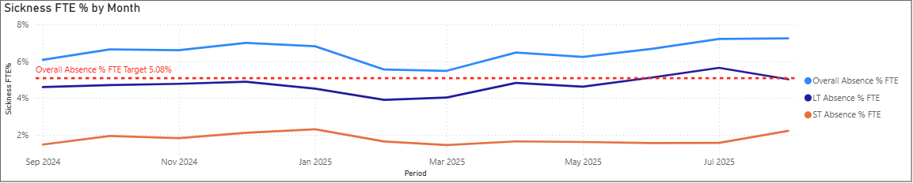
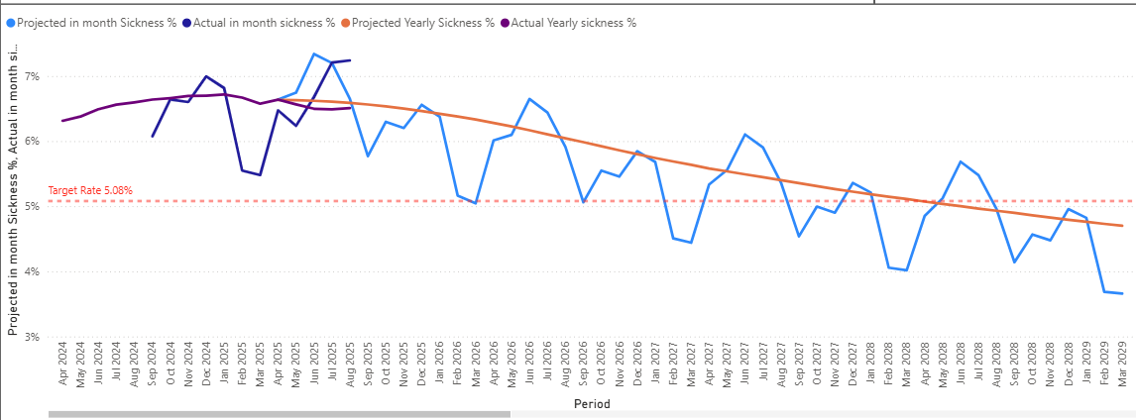
Primary, Community Care & Therapies Absence Trend
In-month, August 2025 sickness absence rate 7.24% against a target of 5.08%. Whilst there is a steady decrease in long term absence, short term absence is increasing.
We have undertaken analysis of historical trends to develop a forecast and trajectory to meet a sickness absence target of 5.08%.
Our Service Group Sickness Absence Action plan was developed to support delivery against our trajectory and demonstrate measures being taken to meet our absence target.

Slide 3
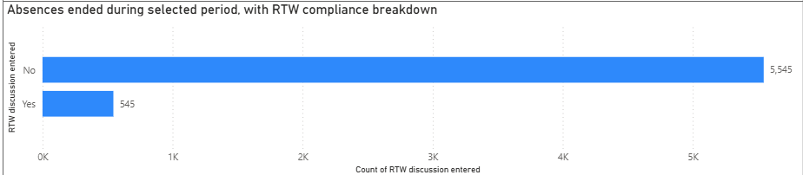
Primary, Community Care & Therapies Absence Trends In-month August 2025
Sickness absence has increased slightly in August to 7.24% from 6.68%, as reported in June 2025. Long term absence reported in August is 5.02%, a reduction since the last reporting period. Short term absence reported in August is 2.22%, an increase of 0.46% since the last reporting period. Primary Community Care & Therapies Service Group remains the Service Group with the lowest level of sickness absence, although the trend of increasing short term absence and decreasing long term absence is aligned with the Health Board position. The highest reason for both long and short-term absences are due to Anxiety, Stress & Depression which is a trend seen across the Health Board. The second highest reason for long term absence is ‘Other known causes’ – due to this, it is difficult to determine the true reason for absence. The Service Group have been provided with guidance on appropriate coding and encouraged to avoid the use of this code. The second highest reason for short term absence is Cough/Cold/Flu – this is likely to increase over the coming months in line with seasonal trends.
The Workforce Dashboard shows that we are currently non-compliant against the new Return to Work indicator, this will therefore be an area of focus for us.

Slide 4
Short Term Sickness Absence
Recent data highlights an increase in short term absence vs long term sickness absence, with the most common reason for short term absence being anxiety/stress related.
A deep dive in Primary Care & Therapies absence confirmed that short term absence due to Anxiety/Stress was predominately linked to personal stress but that there is evidence to support some anxiety/stress was work related. The top 3 factors for personal stress were bereavement, caring for dependants and stress at home.
In order to support employees with anxiety/stress, specifically personal stress as outlined above, Swansea Bay partnered with Carers Wales. The group regularly promotes the resource available to ensure those with caring responsibilities are supported. In addition to promoting the Health Board’s Flexible Working Policy, Bereavement Support groups available to all employees and the Wellbeing Resource pack, outlining all wellbeing support available to employees to encourage ownership of wellbeing.
The Workforce team have updated our Managing Attendance at Work training and bite-size learning modules to ensure there is a clear impetus on compassionate conversations and leadership at all times. The groups HR Business Partnering team have also developed and delivered bespoke sessions tailored to specific hotspot areas to support the reduction of sickness absence.

Slide 5
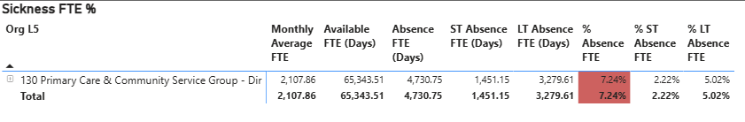
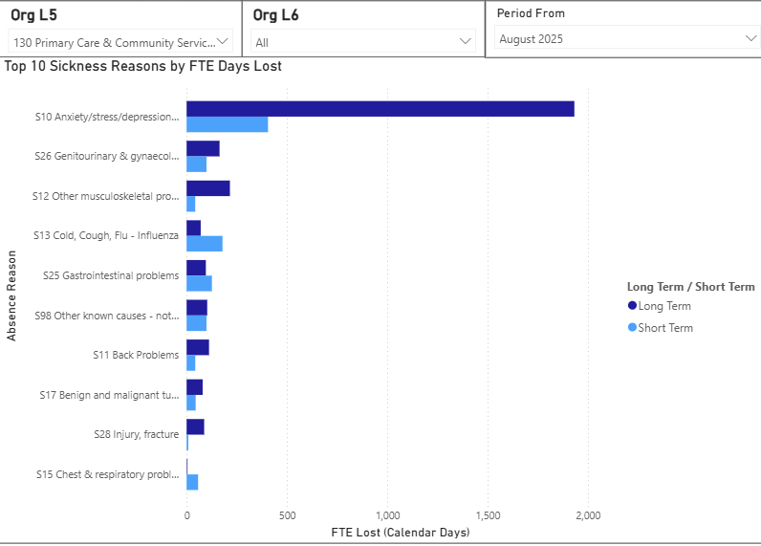
Long Term Sickness Absence
Data in August confirms that 3279.61 days were lost due to long term absence within Primary Care & Therapies.
492 employees have been referred to Occupational Health for an assessment over the last 12 months from across the group.
35 employees are on/approaching half pay.
12 employees are on/approaching nil pay.
Since April 2025, all Final Formal Absence Meetings are taking place at or before 12 months continuous absence in line with Policy.

Slide 6
Absence Prompt Deep Dive – Primary, Community Care & Therapies
178 (6.9%) employees within Primary Community Care & Therapies have reached a review point under the Managing Attendance at Work Policy.
Following a deep dive within the Service Group steps are being taken to ensure all employees attend a review meeting in line with the Managing Attendance at Work Policy.
Managing Attendance at Work Policy compliance audits are being undertaken, targeting hotspot areas, the groups Sickness Absence Action Plan (slides 11-12) sets out measures being undertaken to address areas for improvement.
Managing Attendance at Work training has been carried out across the Service Group and will continue. Bespoke training has also been rolled out to managers on Short Term Sickness Absence management, Return to Work interviews, Long Term Sickness Absence management.
Monthly Scrutiny meetings are also in place with a focus on improving consistent hot spot areas.

Slide 7
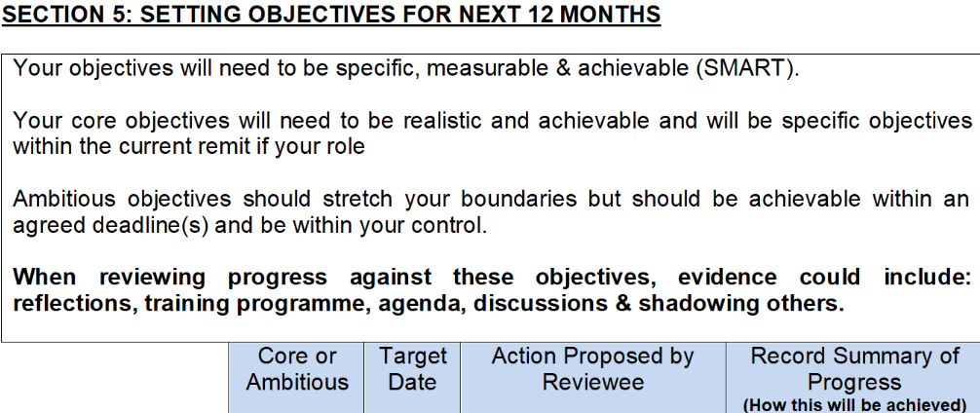
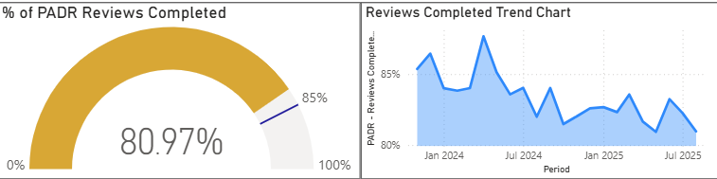
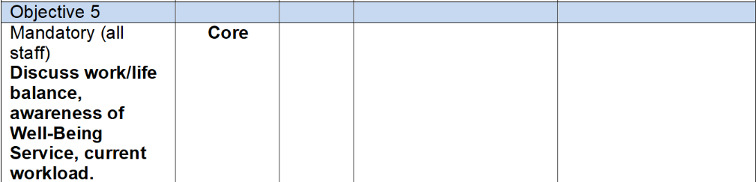
PADRs and Compassionate Leadership Discussions
The annual PADR now includes a specific wellbeing related objective. This is an opportunity for managers to ensure support with health and wellbeing of all employees and that this is regularly reviewed against during the year.
Whilst PADR compliance for the group, reported in August, falls slightly below the 85%. This is monitored at Monthly Service Group performance meetings with agreed recovery trajectories discussed to gain assurance of improved compliance and wellbeing objectives are supported and met.

Slide 8
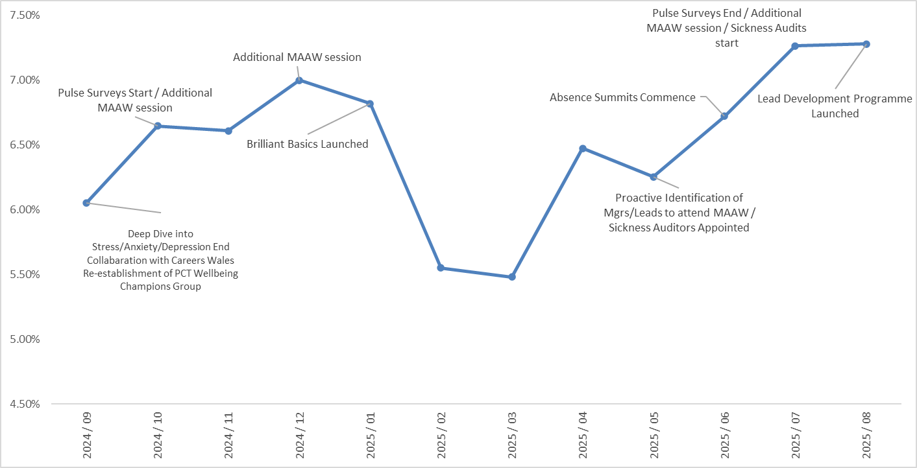
Management of Sickness Absence

Slide 9
Management of Sickness Absence
Timeline | Action | Outcome
July - Sept 2024 | Deep Dive into stress/anxiety/depression sickness reasons | Main reasons identified as: (1) Family Issues (2) Personal health issues (3) Bereavement (4) Work related (5) Caring for another Findings fed back to senior team and development of actions within PCT People Plan
Oct 2024 to July 2025 | Pulse Surveys with local action plans focusing on health and wellbeing | Main themes arising: Staff feeling under pressure leading to work related stress Supportive team working A need for improved and/or re-establishing communication avenues within certain areas Findings fed back to senior team and development of actions within PCT People Plan
Oct 2024 to July 2025 | Additional ‘Managing Attendance at Work’ sessions provided in addition to HB programme | Priority given to managers/leads within hot spot areas To further underpin the development and support of line managers/ leads and their staff
January 2025 | Promotion and engagement of new HB initiative ‘Brilliant Basics’ | To further underpin the development and support of line managers/ leads and their staff
May 2025 | Proactive identification of managers/leads to attend ‘Managing Attendance at Work’ training | Priority given to managers/leads within hot spot areas for development and improved HR support
May to July 2025 | Sickness Auditors appointed / Programme of sickness audits commenced, to focus on hot spot areas | An increased focus and scrutiny on sickness absence within hot spot areas. Impact on service due to resource allocation on sickness audits.
June 2025 | Hot spot areas Absence Summits commenced | Improved policy compliance, improved management education and awareness around managing attendance at work, increase in effectiveness in management of sickness absence within sickness hot spot areas
August 2025 | Promotion and engagement of new HB initiative ‘Lead Development Programme’. | To further underpin the development and support of line managers/ leads and their staff

Slide 10
Primary Care & Therapies Action Plan
Action | Impact/Risk | Date | RAG Status | Comments/
 |  |  |  | Update
Deploy Business Partner (BP) teams to coordinate responses within Service Group (SG) – creating SG teams who will focus on absence | May impact on BP capacity to deal with other work | Immediate Effect |  | Update April 2025 - Monthly Sickness Scrutiny Meetings set up for District Nursing. Update July 2025 - Sickness Auditors appointed and trained, sickness audit programme commenced July 2025. Absence Summits commenced June 2025 in sickness hot spot areas - Deputy Heads of Nursing appointed as Leads. SHRAs undertake monthly review meetings on long term sickness absence ongoing and review LTS cases as part of Open Ended Report. Support offered to line managers and service leads as required. Updated Sickness Pathway in place June 2025 (SHRAs to support at 2nd Formal and from one month of LTS)
Pull dedicated support from HR operations team to work with SG Team to support the audit of 10 hot spot areas for sickness and confirm action plans | Will delay ER processes due to limited capacity within HR Operations team. Will mean other HR work may pause for a while. Impact on TU relations; | Immediate Effect |  | Complete - HR Operations supporting hot spot areas which are discussed during monthly Absence Sumits
Deploy Corporate Nursing to coordinate roster managers on roster efficiency to engage in SG teams – focus of review on efficiency of roster scrutiny process |  | Immediate Effect
Deploy LW from Morriston SG to train SG teams on deep dive audits | Impact SG Morriston as other responsibilities. Capacity minimised if provided for a short period. | Immediate Effect |  | Completed June 25 Auditors in place and have received training on the Morriston Audt tool

Slide 11
Primary Care & Therapies Action Plan
Action | Impact/Risk | Date | RAG Status | Comments/
 |  |  |  | Update
Each SG and Department to deploy someone to coordinate their deep dives and to be trained by LW | Include roster managers as well as a coordinating manager within high hot spot sickness area. | Immediate Effect |  | Completed June 25 Auditors in place and have received training on the Morriston Audt tool
Dashboard Utilisation to help track and manage sickness absence | Minimal/to ensure one source of truth used to track performance. (Risk cross charging vacancies within Establishment Control Dashboard so have to agree principles to manage with Finance) | Immediate Effect |  | Complete - dashboard in use across Service Group and discussed during Absence Summitts
BPs to create and publish a consistent report which will be issued to R&S on a monthly basis | Site by site comparisons, best practice identification | w/c 14th April |  | Complete- Performance report agreed and in use
Each BP team to coordinate a review of those staff who have exhausted sick pay (currently circa 59 on nil pay and 79 further approaching) | National impact of policy approach. Custom & Practice has been to allow to remain on. Therefore impact on TU relations. Already experiencing this following more recent proactive management. ET claims. | Immediate Effect |  | In place and ongoing - As part of the Service Group Absence Summitts we review all those on nil pay - BP teams oversee action plan and ensure that the leaders to work with the Ops team to progress these cases
OH to prioritise nil pay group for review. BP team to ensure “effective” OH referral” and support to be given for longer term locum in OH to speed up timescales. | General staff engagement, presenteeism, disability discrimination, TU relations and ET claims | TBC (will depend on locum cover for PH being approved) |  | In place and ongoing - escalate discussions with OH team to review current status of cases - on a case by case basis the ops team and leader will review with OH where more clarity is required - overseen by the HRBP teams in line with the action plan

