Slide 1

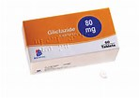
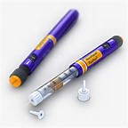
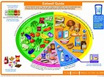
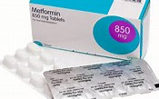
HYPOGLYCAEMIA
[name redacted]
(supported by DSNs)
Diabetes Specialist Nurse(s)
Cardiff and Vale
University Health Board

Slide 2

How to define hypoglycaemia
HYPOGLYCAEMIA
?? 1.9mmol, 2.4mmol, 3.6mmol, 4.0mmol, 4.6mmol, 5.2mmol, 7.4mmols ??

Slide 3
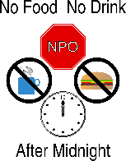
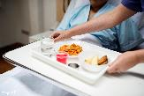



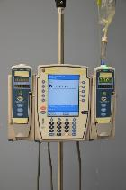

Causes of hypoglycaemia
HYPOGLYCAEMIA
Timing?
Too much insulin or medication
Increase in activity (including physio in hospital

Slide 4
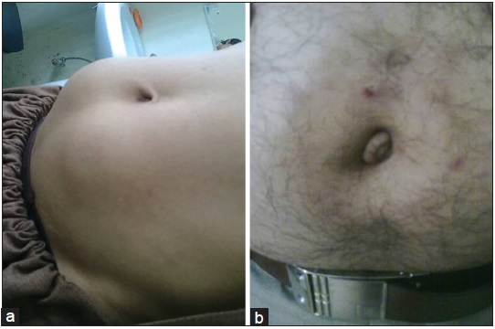
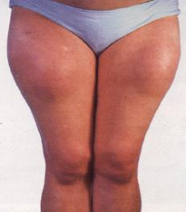
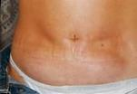
Lipohypertrophy
(LIPOs)
HYPOGLYCAEMIA

Slide 5
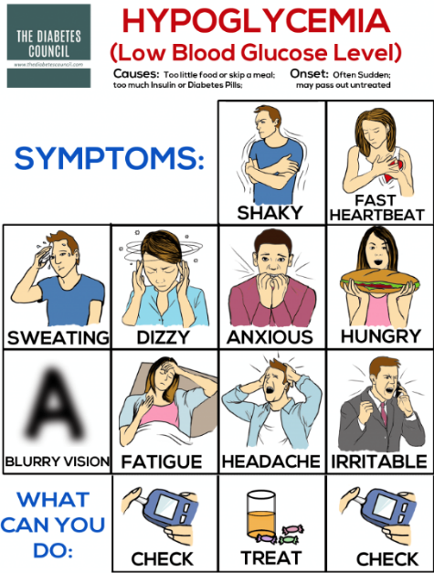
Symptoms of Hypoglycaemia
HYPOGLYCAEMIA

Slide 6
Symptoms of Hypoglycaemia
Autonomic symptoms
Neuroglycopenic symptoms
Hypoglycaemic unawareness
HYPOGLYCAEMIA

Slide 7
Autonomic signs and symptoms
Initial response to Hypoglycaemia
HYPOGLYCAEMIA
Sweating
Feeling shaky
Tachycardia
Change in colour
Anxiety
Feeling hungry
Feeling tired/Yawning

Slide 8
Neuroglycopenic signs and symptoms
Secondary responses as glucose falls
Headache
Visual disturbance
Tingling of lips
Feeling faint/light headed
Irritable/Aggressive
Slurred speech
Disorientated/Confused
Unconsciousness
HYPOGLYCAEMIA
Notes:
HYPO UNAWARENESS

Slide 9
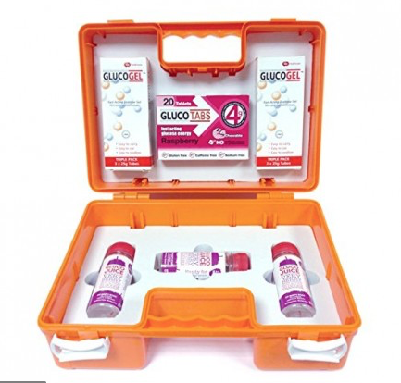
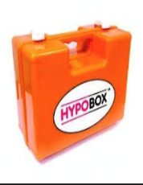


Cardiff & Vale UHB Hospital Hypo Treament
HYPOGLYCAEMIA

Slide 10







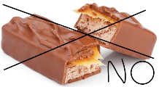
Alternative Hypo Treatments for patient self-managing
HYPOGLYCAEMIA
Notes:
Repeat after 15mins

Slide 11

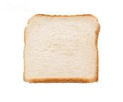

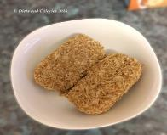
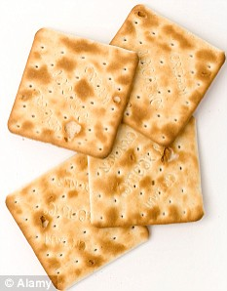
Post Hypo Care
HYPOGLYCAEMIA
Give 20g of long acting carbohydrate
Examples:
1 medium slice of white bread = 15g
1 medium slice of wholemeal bread = 14g
1 custard cream biscuit = 8g
1 cream cracker 6g
1 medium bowl of cornflakes = 27g
1 Weetabix = 14g
1 medium banana = 20g
Notes:
Treat the hypo as an event

Slide 12
Algorithm for the Treatment and Management of Hypoglycaemia in Adults with Diabetes Mellitus in Hospital
Hypoglycaemia is defined as blood glucose of less than 4mmol/l (if not less than 4mmol/l but symptomatic give a small carbohydrate snack for symptom relief )
Mild
Moderate
Severe
Patient conscious, orientated and able to swallow
Patient conscious and able to swallow but confused/disorientated or aggressive
Patient unconscious/fitting or very aggressive or nil by mouth (NBM)
Give 3 – 5 tablets of GlucoTabs or
59ml GlucoJuice Liquid Blast
Test blood glucose level after 15 minutes
If still less than 4 mmol/L , repeat above up
to 3 times
If this has been repeated 3 times, consider IV 10% glucose at 100 ml/hr Continue to test blood glucose every 15 minutes until >4mmols/L
If cooperative:
administer 1-2 tubes of GlucoGel
Ensure gag reflex is present
If uncooperative: give 1mg Glucagon IM if suitable (i.e. no repeated hypos, not NBM and no severe hepatic disease)
Test blood glucose after 15 minutes, if still less than 4 mmol/L, repeat up to 3 times.
If this has been repeated 3 times, consider IV 10% glucose at 100 ml/hr Continue to test blood glucose every 15 minutes until >4mmols/L
Check ABC, stop any IV insulin and fast bleep a doctor
If suitable (i.e. no repeated hypos, patient not NBM and no severe hepatic disease) give 1 mg Glucagon IM or give IV 10% Dextrose 150mls over 5 minutes If still less than 4 mmol/L, repeat above up to 3 times.
If this has been repeated 3 times, consider IV 10% glucose at 100 ml/hr Continue to test blood glucose every 15 minutes until >4mmols/L
Blood glucose level should now be above 4mmol/L.
Give 20g of long acting carbohydrate e.g. 2 biscuits or a slice of bread or next meal if due.
If IM Glucagon has been used give 40g of long acting carbohydrate in order to replenish glycogen stores.
For enteral feeding patients ONLY: give 200mls milk (not soya) or restart feed or give IV 10% glucose at 100ml/hr
Blood glucose should now be above 4mmol/L. Follow up treatment as described on the left.
If NBM start 10% glucose infusion at 100ml/hr until no longer NBM or reviewed by doctor
DO NOT OMIT SUBSQUENT DOSES OF INSULIN
CONTINUE REGULAR BLOOD GLUCOSE MONITORING FOUR TIMES A DAY FOR 48 HOURS OR UNTIL STABLE
GIVE HYPOGLYCAEMIA EDUCATION OR REFER TO DIABETES SPECIALIST NURSE FOR ADVICE - Bleep 6502 UHW, Bleep 6503 UHL
CONSIDER POSSIBLE CAUSE FOR HYPOGLYCAEMIA AND SEEK TO PREVENT FURTHER EPISODES FROM OCCURRING
Notes:
IM glucagon must not be given to patients below 20kg or with severe hepatic disease

Slide 14
Post Hypo Safety and Documentation
Always treat a hypo as an event and remember not to omit the patients next dose of oral hypoglycaemic agent or insulin!
Always inform the doctor on the ward
Document the event/s in the patients notes with the post hypo care you have given
Consider referral to in-patient DSN:
‘E-referral system on via E-comms on CavWeb’
Faxed referrals NO LONGER ACCEPTED
*Note Referral to the DSN service for a hypo event may not always be necessary or appropriate*
HYPOGLYCAEMIA

Slide 15
Can you….
Define hypoglycaemia?
List signs and symptoms?
Discuss the treatment & management for in-patients?
Repeat some of the common causes?
Discuss post hypo care?
Refer to DSN as appropriate?
HYPOGLYCAEMIA
Diabetes Nursing Service generic Email contact: Diabetesnursing.Cav@wales.nhs.uk
Sue Flanigan DSN Email contact: susan.flanigan@wales.nhs.uk Tel: UHL Ext 25651
Useful links: www.cdep.org.uk www.diabetes.org.uk

Slide 16
Important information Re: DRIVING
By law the patient must inform the DVLA if they are on insulin or injectable therapies and/or oral hypoglycaemic agents that are likely to cause hypoglycaemia
The patient must declare that they have diabetes to their car insurance company
The DVLA have tight rules and regulations; patients should have a glucose monitor & must check glucose before & driving. The BG meter should also store a history for at least 3 months
https://www.gov.uk/government/publications/information-for-drivers-with-diabetes
DVLA ADVICE

Slide 17
DVLA & Hypoglycaemia risk
Glucose must be above 5mmols/l to drive *5 to Drive*
If the patient becomes symptomatic whilst driving they should start their hypo treatment immediately, then find a safe place to pull over
ALWAYS carry hypo treatment and a BG meter
Turn the ignition off and move from the drivers seat
Always carry a carbohydrate snack
Glucose must be above 5mmols/l for 45 minutes before returning to drive
HYPOGLYCAEMIA

Slide 18

Thank you, any questions??
HYPOGLYCAEMIA
Diabetes Nursing Service generic Email contact: Diabetesnursing.Cav@wales.nhs.uk
[readacted]
Useful links: www.cdep.org.uk www.diabetes.org.uk

